Slide 1
Chapter :Introduction to International Finance
Chapter 1 in Dipak
Chapter 2 in Iyer

Slide 2
Meaning:
International Finance is an area of financial economics that deals with monetary interactions between two or more countries
Concerning itself with topics such as currency exchange rates, international monetary systems, FDI, and issues of international financial management
Including political risk and foreign exchange risk inherent in managing multinational corporations.

Slide 3
Scope of IF
With increasing volumes and complexities of international business, the study of international finance has become a specialized subject dealing with study of-
Foreign exchange markets
Exchange rates
MNC financial systems
Risk management
International accounting systems

Slide 4
Q’s usually addressed under IF
Should emerging market economies liberalize their financial markets
What has happened (what will happen) to the dollar
Is the current account deficit too large?
Should China devalue its Yuan
Is this good for world economic growth, or a source of instability
How, if at all, should we reform the IMF

Slide 5
Components of IF
Components
Foreign currency Mkts (lending & borrowing)
Foreign exchange Mkts ( paying for EX-IM)
Capital mkts ( Bonds, debentures, ADR, GDR etc)

Slide 6
Features of IF
Expanded opportunities to business
Forex Risk
Imperfect markets
Political risk

Slide 7
Importance of IF
International finance helps in understanding inflation rates, interest rates, financial risks etc

Slide 8
BOP
The balance of payments (BOP) of a country is the record of all economic transactions between the residents of a country and the rest of the world in a particular period
It is a method countries use to monitor all international monetary transactions at a specific period of time
These transactions can be made by individuals, firms and government bodies.

Slide 9
Current Account | Capital Account
Export and Import of Goods (Merchandise Transactions or Visible Trade) also called BOT Balance of Trade | Loans (borrowing & Lending)
Export and Import of Services (Invisible Trade) travel, transportation, insurance, other misc services, transfer of interest, dividends profits, remittance (gifts) | Investments (issue of equity, bonds, term loans, acquisition of assets)
Non monetary Gold | Private, Banking, Government

Slide 10
Third Component of BOP: Reserve A/c
Stock of foreign currency denominated assets held by monetary authority of the country
Includes Forex reserves of RBI
Monetary Gold
Contribution to IMF
SDR by IMF

Slide 11
SDR
The SDR is an international reserve asset, created by the IMF in 1969 to supplement its m
The SDR is neither a currency nor a claim on the IMF. Rather, it is a potential claim on the freely usable currencies of IMF members.
SDRs can be exchanged for these currencies member countries’ official reserves

Slide 12
SDR
The SDR basket is reviewed every five years, or earlier if warranted, to ensure that the SDR reflects the relative importance of currencies in the world’s trading and financial systems.
During the last review concluded in November 2015, the Board decided that the Chinese renminbi (RMB) met the criteria for inclusion in the SDR basket

Slide 13
Criteria for inclusion in the SDR basket
Export criterion:
Issuer of currency is an IMF member or a monetary union, that includes IMF members, who is one of the top five exporters of the world.
Determined to be “freely usable” currency by the IMF
Currency is widely used to make payments for international transactions and widely traded in the principal exchange markets

Slide 14
SDR
Currency | Weights determined in the 2015 Review | Fixed Number of Units of Currency for a 5-year period Starting Oct 1, 2016
U.S. Dollar | 41.73 | 0.58252
Euro | 30.93 | 0.38671
Chinese Yuan | 8.33 | 1.0174
Japanese Yen | 8.09 | 11.900
Pound Sterling | 10.92 | 0.085946

Slide 15
Quantitative easing (QE)
'Quantitative Easing' is an unconventional monetary policy in which a central bank purchases government securities or other securities from the market in order to lower interest rates and increase the money supply
Central banks are responsible for keeping inflation in check

Slide 16
Before the financial crisis
Before the financial crisis of 2008-09 Central bank managed that (inflation) by adjusting the interest rate at which banks borrow overnight
If firms were growing nervous about the future and scaling back on investment, the central bank would reduce the overnight rate
That would reduce banks' funding costs and encourage them to make more loans, keeping the economy from falling into recession.

Slide 17
During Crisis
When the crisis struck, big central banks like the Fed and the Bank of England slashed their overnight interest-rates to boost the economy.
But even cutting the rate as far as it could go, to almost zero, failed to spark recovery.
CB started using new tool for managing inflation called QE

Slide 18
How QE works
To carry out QE central banks create money by buying securities, such as government bonds, from banks, with electronic cash that did not exist before.
The new money swells the size of bank reserves in the economy by the quantity of assets purchased—hence "quantitative" easing.
QE is supposed to stimulate the economy by encouraging banks to make more loans.
Due to QE interest rates on everything from government bonds to mortgages to corporate debt are lower

Slide 19
Effects of QE
If QE convinces markets that the central bank is serious about fighting deflation or high unemployment, then it can also boost economic activity by raising confidence.

Slide 20
Transactions: BOP
Autonomous Transaction/ transactions above the line. Undertaken in normal course of business, Usually imbalanced
Accommodating Transaction/ transactions below the line, undertaken to balance BOP undertaken by government & RBI

Slide 21
Convertibility of currency
Convertibility essentially means the ability of residents and non-residents to exchange domestic currency for foreign currency, without limit, whatever be the purpose of the transaction
Convertibility means procedural liberalization and does not mean unlimited conversion
Types:
Fully Convertible
Partially Convertible
Non Convertible

Slide 22
CAC

Slide 26
TARAPORE COMMITTEE RECOMMENDATIONS: kindly browse through internet

Slide 27
Chapter 2: International Monetary Systems

Slide 28
World Exchange rate Systems
Gold Standard System:
Before World War I, nearly all of the world economy was on the gold standard
A government would define a unit of its currency as worth a particular amount of gold
the currency was convertible
could be converted into gold freely
the currency’s price in terms of gold was its parity

Slide 29
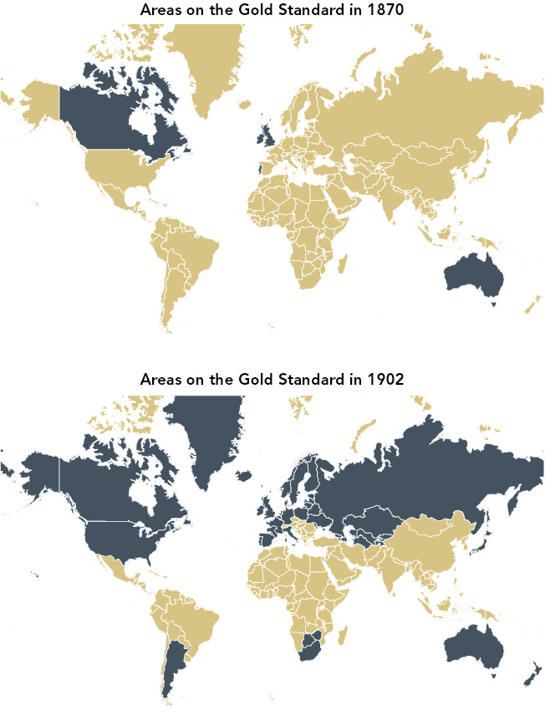
Figure 15.2 - Growth of the Gold Standard

Slide 30
Gold Species System
Actual gold coins or gold coins with fixed content of gold were in circulation
It could be bi-metallic or mono metallic
The conversion ratios were fixed eg: 10silver coins = 1 gold coin etc
Value of gold coin was equal to the content of gold in the coin
Gold was freely imported & exported
Supply of gold determined the liquidity & consequently its value

Slide 31
Gold Bullion Standard
The gold bullion standard is a system in which gold coins do not circulate, but the authorities agree to sell gold bullion on demand at a fixed price in exchange for the circulating currency.
The gold bullion standard usually does not involve the circulation of gold coins.
Monetary authorities hold stock of Gold
There is written promise on the currency note that if you demand on submission of gold you would get a specified quantity of Gold

Slide 32
Mint par exchange /Par value system
1 gm of gold = 10 Units of currency ‘X’
1 gm of gold = 20 Units of currency ‘Y’
0.5 Unit of X = 1 Units of Y
Exchange rate between X & Y is 0.5:1
Exchange rates are calculated between currencies depending upon content of gold in them

Slide 33
Gold Exchange Standard
A monetary system by which one country's currency, which is not itself based on the gold standard, is kept at a par with another currency that is based on the gold standard
Currency is converted in to another at a specified ratio as decided by the monetary authority
The currency with which it is pegged is called as reserve currency, which in turn is converted in to Gold

Slide 34
Advantages of GSS
Imposes monetary discipline on economies
Inbuilt anti-inflationary system
Less fluctuations in foreign exchange rates
More certain & predictable movement of forex rates

Slide 35
Disadvantages of GSS
Rigid monetary policies
Often leads to many economic compromises
Political costs
Difficulties during period of war, earthquakes etc
Too high and unlimited liability of government

Slide 36
End of Gold standards
Impact of World War I
Governments with insufficient tax revenue suspended convertibility repeatedly in the 19th century
the system could not deal quickly enough with the large balance of payments deficits and surpluses
rapid technological change

Slide 37
End of Gold standards
Impact of WWII & Great depression
Adherence to the gold standard prevented the Federal Reserve from expanding the money supply to stimulate the economy, fund insolvent banks and fund government deficits that could "prime the pump" for an expansion.
Higher interest rates intensified the deflationary pressure on the dollar and reduced investment in U.S. banks.

Slide 38
Bretton Woods System
The Bretton Woods System was the result of an international monetary conference that took place in 1944
USA undertook to convert USD freely onto Gold at a fixed parity 35USD = 1 ounce(31.10 grams) of gold
Other currencies agreed to maintain their currencies at specific parity with USD
+/- 1% fluctuations in parity was allowed, beyond which government intervention was required

Slide 39
Bretton Woods System
No obligation on part of non- reserve countries to exchange their currencies for gold
Only reserve country had that obligation of conversion
In case of severe foreign exchange problem change in parity up to +/-10% was allowed with prior permission of IMF (Adjustable Peg System)

Slide 40
Three major Principles of BWS
Three principles guided this system
in ordinary times, exchange rates should be fixed
in extraordinary times, exchange rates should be changed
an institution was needed to watch over the international financial system

Slide 41
Triffin’s Paradox
The postwar "dollar gap" abroad had become a "dollar glut" by 1960.
The concept that a national currency that is also a reserve currency will eventually run a deficit, which eventually inspires a lack of confidence in the reserve currency and leads to a financial crisis.
On the one hand, the international economy needed dollars for liquidity purposes and to satisfy demand for reserve assets. But this forced, or at least made it easy, for the US to run consistently large current account deficits.

Slide 42
Triffin argued that such persistent deficits would eventually put pressure on the dollar and lead to the demise of the Bretton Woods system of international exchange.
The demands on an international currency meant that excess supply would undermine its value.
To be I’nal strong currency it has to maintain steady flow of USD in country (creating CAD)
Such deficit would weaken USD hence a contradiction arises

Slide 43
Collapse of BWS
Rising inflation in USA
Dollar overhang: when USD held by non reserve country’s exceeded total amount of Gold held by USA
It became obvious that USA could run out of Gold

Slide 44
Collapse of BWS
With anticipation that value of USD would fall counties started to convert their reserves in to gold
Devaluation of USD

Slide 45
Smithsonian Agreement
The Smithsonian Agreement led to an approximately 8% devaluation of the U.S. dollar, and raised the price of gold from $35 to $38.
Intervention points were agreed at +/-2.25%
Since it did not addressed concerns of Triffin’s paradox impact of this agreement lasted for very short period of time

Slide 46
Chapter 3: Current exchange rates systems

Slide 47
Present Exchange Rate System
Fixed/ (Pegged)/ Hard Peg with one currency
Rates that governments agree on and undertake to maintain
A fixed exchange rate is a commitment by a country to buy and sell its currency at fixed, unchanging prices (in terms of other currencies)

Slide 48
Present Exchange Rate System
Fixed/ (Pegged)/ Hard Peg with one currency
The central bank or Treasury must maintain foreign exchange reserves
These reserves are limited
Heavy burden on exchange rates
Fails to solve problems of BOP disequilibrium
Does not prevents real shocks

Slide 49
Present Exchange Rate System
Lot of intervention of government
Less inflationary
Prevents monetary shocks esp. for importers & exporters
Provides less opportunity for speculation

Slide 50
Free Float/ Flexible Ex. Rate system
Rates that are allowed to float against other currencies and are determined by market forces
Generally used by developed countries
Simple operation, smoother, more fluid adjustment
Brings realism in transaction
Disequilibrium in BOP gets auto-stablized
Gives opportunity of speculations

Slide 51
Free Float/ Flexible Ex. Rate system
Encourages inflation
Creates problems for economic health of the country
Exchange rate risk to exporters & importers
Cost of hedging increases cost of trade

Slide 52
Dirty/ managed float (India follows)
Managed float regime is the current international financial environment in which exchange rates fluctuate from day to day, but central banks attempt to influence their countries‘ exchange rates by buying and selling currencies.
Timely interventions of monetary authority is expected

